Slide 1
Lecture 4: Internetworking Protocols
Application Layer

Slide 2
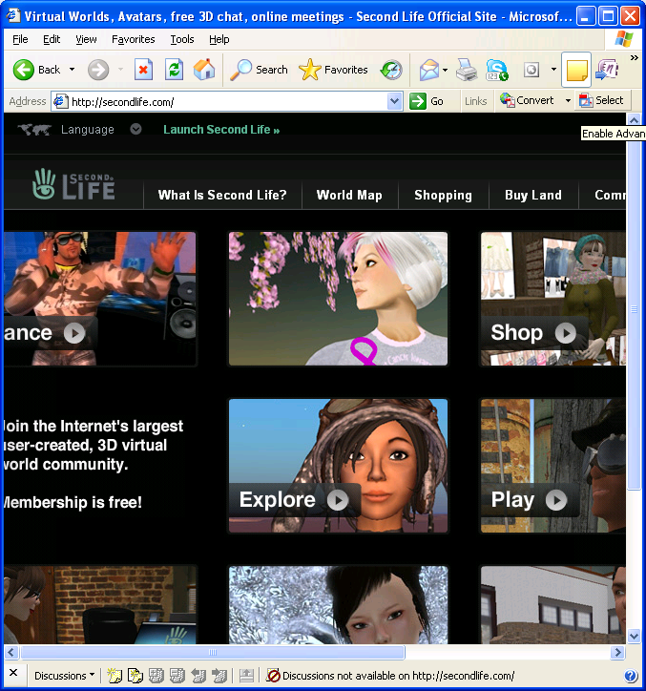
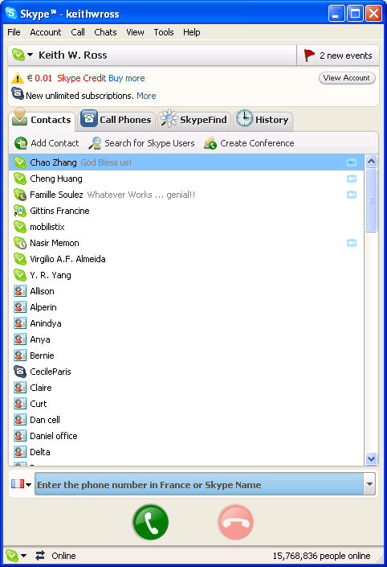
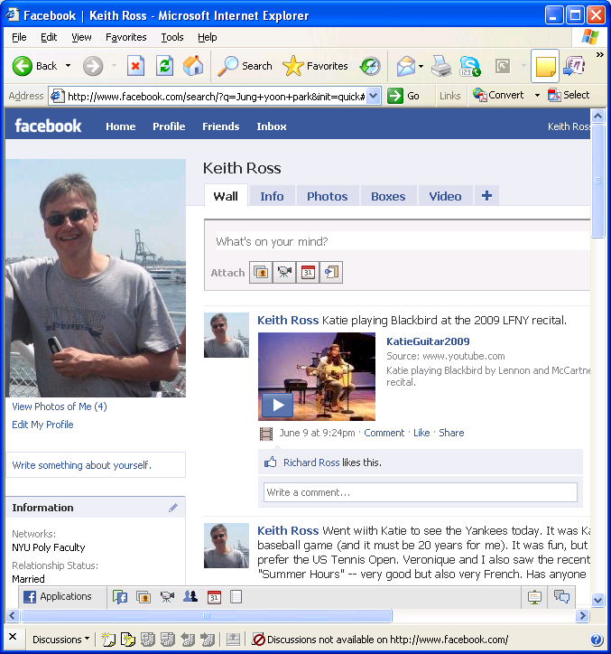
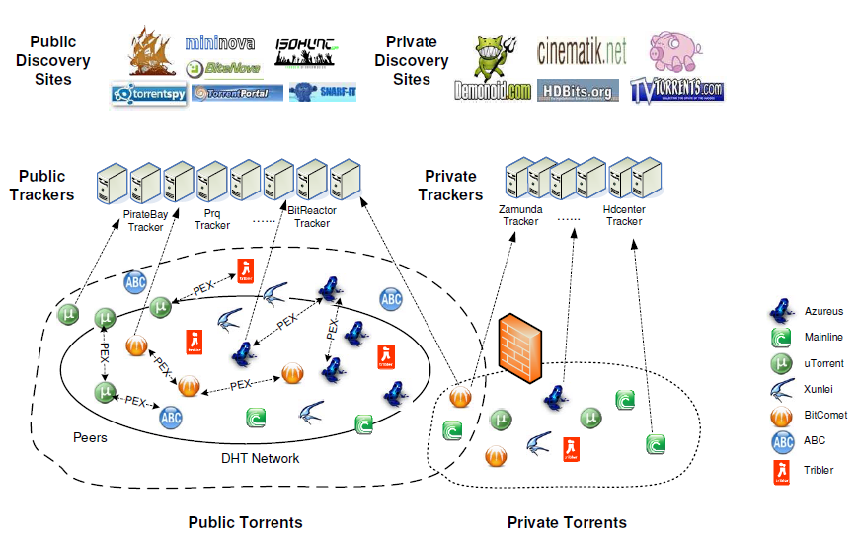
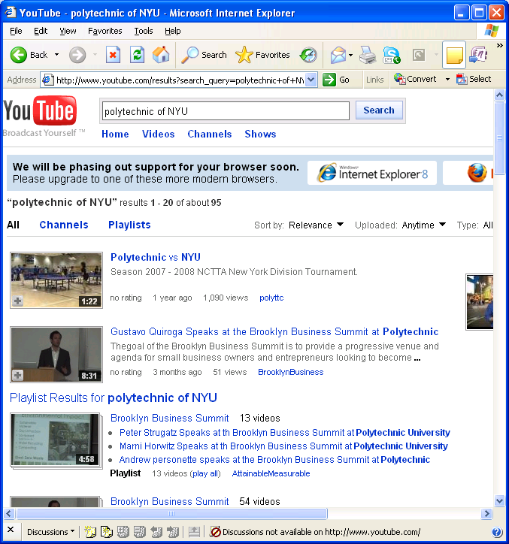

Slide 3
Some network apps
social networks
voice over IP
real-time video conferencing
grid computing
e-mail
web
instant messaging
remote login
P2P file sharing
multi-user network games
streaming stored video clips
2: Application Layer

Slide 4





Creating a network app
application
transport
network
data link
physical
write programs that
run on (different) end systems
communicate over network
e.g., web server software communicates with browser software
No need to write software for network-core devices
Network-core devices do not run user applications
applications on end systems allows for rapid app development, propagation
application
transport
network
data link
physical
application
transport
network
data link
physical
2: Application Layer

Slide 5
Application architectures
Client-server
Including data centers / cloud computing
Peer-to-peer (P2P)
Hybrid of client-server and P2P
2: Application Layer

Slide 6
Client-server architecture
server:
always-on host
permanent IP address
server farms for scaling
clients:
communicate with server
may be intermittently connected
may have dynamic IP addresses
do not communicate directly with each other
client/server
2: Application Layer

Slide 7
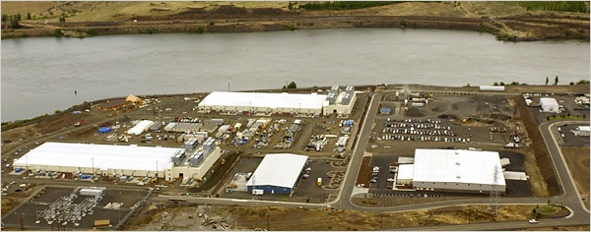
Google Data Centers
Estimated cost of data center: $600M
Google spent $10.9B in 2016 on new data centers
Each data center uses 50-100 megawatts of power
2: Application Layer

Slide 8
Pure P2P architecture
no always-on server
arbitrary end systems directly communicate
peers are intermittently connected and change IP addresses
Highly scalable but difficult to manage
peer-peer
2: Application Layer

Slide 9
Hybrid of client-server and P2P
Skype
voice-over-IP P2P application
centralized server: finding address of remote party:
client-client connection: direct (not through server)
Instant messaging
chatting between two users is P2P
centralized service: client presence detection/location
user registers its IP address with central server when it comes online
user contacts central server to find IP addresses of buddies
2: Application Layer

Slide 10
Processes communicating
Process: program running within a host.
within same host, two processes communicate using inter-process communication (defined by OS).
processes in different hosts communicate by exchanging messages
Client process: process that initiates communication
Server process: process that waits to be contacted
Note: applications with P2P architectures have client processes & server processes
2: Application Layer

Slide 11
Sockets
process sends/receives messages to/from its socket
socket analogous to door
sending process shoves message out door
sending process relies on transport infrastructure on other side of door which brings message to socket at receiving process
host or
server
host or
server
controlled by
app developer
process
process
socket
socket
TCP with
buffers,
variables
TCP with
buffers,
variables
Internet
controlled
by OS
API: (1) choice of transport protocol; (2) ability to fix a few parameters (lots more on this later)
2: Application Layer

Slide 12
Addressing processes
Q: does IP address of host on which process runs suffice for identifying the process?
A: No, many processes can be running on same
Identifier includes both IP address and port numbers associated with process on host.
Example port numbers:
HTTP server: 80
Mail server: 25
to receive messages, process must have identifier
host device has unique 32-bit IP address
Exercise: use ipconfig from command prompt to get your IP address (Windows)
2: Application Layer

Slide 13
App-layer protocol defines
Types of messages exchanged,
e.g., request, response
Message syntax:
what fields in messages & how fields are delineated
Message semantics
meaning of information in fields
Rules for when and how processes send & respond to messages
Public-domain protocols:
defined in RFCs
allows for interoperability
e.g., HTTP, SMTP, BitTorrent
Proprietary protocols:
e.g., Skype, ppstream
2: Application Layer

Slide 14
What transport service does an app need?
Data loss
some apps (e.g., audio) can tolerate some loss
other apps (e.g., file transfer, telnet) require 100% reliable data transfer
Throughput
some apps (e.g., multimedia) require minimum amount of throughput to be “effective”
other apps (“elastic apps”) make use of whatever throughput they get
Security
Encryption, data integrity, …
Timing
some apps (e.g., Internet telephony, interactive games) require low delay to be “effective”
2: Application Layer

Slide 15
Transport service requirements of common apps
Application
file transfer
e-mail
Web documents
real-time audio/video
stored audio/video
interactive games
instant messaging
Data loss
no loss
no loss
no loss
loss-tolerant
loss-tolerant
loss-tolerant
no loss
Throughput
elastic
elastic
elastic
audio: 5kbps-1Mbps
video:10kbps-5Mbps
same as above
few kbps up
elastic
Time Sensitive
no
no
no
yes, 100’s msec
yes, few secs
yes, 100’s msec
yes and no
2: Application Layer

Slide 16
Internet transport protocols services
TCP service:
connection-oriented: setup required between client and server processes
reliable transport between sending and receiving process
flow control: sender won’t overwhelm receiver
congestion control: throttle sender when network overloaded
does not provide: timing, minimum throughput guarantees, security
UDP service:
unreliable data transfer between sending and receiving process
does not provide: connection setup, reliability, flow control, congestion control, timing, throughput guarantee, or security
Q: why bother? Why is there a UDP?
2: Application Layer

Slide 17
Internet apps: application, transport protocols
Application
layer protocol
SMTP [RFC 2821]
Telnet [RFC 854]
HTTP [RFC 2616]
FTP [RFC 959]
HTTP (eg Youtube), RTP [RFC 1889]
SIP, RTP, proprietary
(e.g., Skype)
Underlying
transport protocol
TCP
TCP
TCP
TCP
TCP or UDP
typically UDP
Application
e-mail
remote terminal access
Web
file transfer
streaming multimedia
Internet telephony
2: Application Layer

Slide 18
Chapter 2: Application layer
2.6 P2P applications
2.7 Socket programming with UDP
2.8 Socket programming with TCP
2.1 Principles of network applications
2.2 Web and HTTP
2.3 FTP
2.4 Electronic Mail
SMTP, POP3, IMAP
2.5 DNS
2: Application Layer

Slide 19
Web and HTTP
First some jargon
Web page consists of objects
Object can be HTML file, JPEG image, Java applet, audio file,…
Web page consists of base HTML-file which includes several referenced objects
Each object is addressable by a URL
Example URL:
www.someschool.edu/someDept/pic.gif
host name
path name
2: Application Layer

Slide 20
HTTP overview
HTTP: hypertext transfer protocol
Web’s application layer protocol
client/server model
client: browser that requests, receives, “displays” Web objects
server: Web server sends objects in response to requests
HTTP request
PC running
Explorer
HTTP response
HTTP request
Server
running
Apache Web
server
HTTP response
Mac running
Navigator
2: Application Layer

Slide 21
HTTP overview (continued)
Uses TCP:
client initiates TCP connection (creates socket) to server, port 80
server accepts TCP connection from client
HTTP messages (application-layer protocol messages) exchanged between browser (HTTP client) and Web server (HTTP server)
TCP connection closed
HTTP is “stateless”
server maintains no information about past client requests
aside
Protocols that maintain “state” are complex!
past history (state) must be maintained
if server/client crashes, their views of “state” may be inconsistent, must be reconciled
2: Application Layer

Slide 22
HTTP connections
Nonpersistent HTTP
At most one object is sent over a TCP connection.
Persistent HTTP
Multiple objects can be sent over single TCP connection between client and server.
2: Application Layer

Slide 23
Nonpersistent HTTP
(contains text,
references to 10
jpeg images)
Suppose user enters URL www.someSchool.edu/someDepartment/home.index
1a. HTTP client initiates TCP connection to HTTP server (process) at www.someSchool.edu on port 80
1b. HTTP server at host www.someSchool.edu waiting for TCP connection at port 80. “accepts” connection, notifying client
2. HTTP client sends HTTP request message (containing URL) into TCP connection socket. Message indicates that client wants object someDepartment/home.index
3. HTTP server receives request message, forms response message containing requested object, and sends message into its socket
time
2: Application Layer

Slide 24
Nonpersistent HTTP (cont.)
4. HTTP server closes TCP connection.
5. HTTP client receives response message containing html file, displays html. Parsing html file, finds 10 referenced jpeg objects
time
6. Steps 1-5 repeated for each of 10 jpeg objects
2: Application Layer

Slide 25
Non-Persistent HTTP: Response time
Definition of RTT: time for a small packet to travel from client to server and back.
Response time:
one RTT to initiate TCP connection
one RTT for HTTP request and first few bytes of HTTP response to return
file transmission time
total = 2RTT+transmit time
initiate TCP
connection
RTT
request
file
RTT
time to
transmit
file
file
received
time
time
2: Application Layer

Slide 26
Persistent HTTP
Nonpersistent HTTP issues:
requires 2 RTTs per object
OS overhead for each TCP connection
browsers often open parallel TCP connections to fetch referenced objects
Persistent HTTP
server leaves connection open after sending response
subsequent HTTP messages between same client/server sent over open connection
client sends requests as soon as it encounters a referenced object
as little as one RTT for all the referenced objects
2: Application Layer

Slide 27
HTTP request message
two types of HTTP messages: request, response
HTTP request message:
ASCII (human-readable format)
request line
(GET, POST,
HEAD commands)
GET /somedir/page.html HTTP/1.1
Host: www.someschool.edu
User-agent: Mozilla/4.0
Connection: close
Accept-language:fr
(extra carriage return, line feed)
header
lines
Carriage return,
line feed
indicates end
of message
2: Application Layer

Slide 28
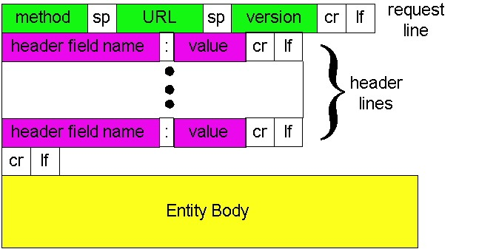
HTTP request message: general format
2: Application Layer

Slide 29
Uploading form input
Post method:
Web page often includes form input
Input is uploaded to server in entity body
URL method:
Uses GET method
Input is uploaded in URL field of request line:
www.somesite.com/animalsearch?monkeys&banana
2: Application Layer

Slide 30
Method types
HTTP/1.0
GET
POST
HEAD
asks server to leave requested object out of response
HTTP/1.1
GET, POST, HEAD
PUT
uploads file in entity body to path specified in URL field
DELETE
deletes file specified in the URL field
2: Application Layer

Slide 31
HTTP response message
status line
(protocol
status code
status phrase)
HTTP/1.1 200 OK
Connection close
Date: Thu, 06 Aug 1998 12:00:15 GMT
Server: Apache/1.3.0 (Unix)
Last-Modified: Mon, 22 Jun 1998 …...
Content-Length: 6821
Content-Type: text/html
data data data data data ...
header
lines
data, e.g.,
requested
HTML file
2: Application Layer

Slide 32
HTTP response status codes
In first line in server->client response message.
A few sample codes:
200 OK
request succeeded, requested object later in this message
301 Moved Permanently
requested object moved, new location specified later in this message (Location:)
400 Bad Request
request message not understood by server
404 Not Found
requested document not found on this server
505 HTTP Version Not Supported
2: Application Layer

Slide 33
User-server state: cookies
Example:
Susan always access Internet always from PC
visits specific e-commerce site for first time
when initial HTTP requests arrives at site, site creates:
unique ID
entry in backend database for ID
Many major Web sites use cookies
Four components:
1) cookie header line of HTTP response message
2) cookie header line in HTTP request message
3) cookie file kept on user’s host, managed by user’s browser
4) back-end database at Web site
2: Application Layer

Slide 34
Cookies: keeping “state” (cont.)
client
server
ebay 8734
usual http request msg
Amazon server
creates ID
1678 for user
cookie file
usual http response
Set-cookie: 1678
create
entry
ebay 8734
amazon 1678
usual http request msg
cookie: 1678
cookie-
specific
action
access
one week later:
usual http response msg
backend
database
access
ebay 8734
amazon 1678
usual http request msg
cookie: 1678
cookie-
spectific
action
usual http response msg
2: Application Layer

Slide 35
Cookies (continued)
aside
What cookies can bring:
authorization
shopping carts
recommendations
user session state (Web e-mail)
Cookies and privacy:
cookies permit sites to learn a lot about you
you may supply name and e-mail to sites
How to keep “state”:
protocol endpoints: maintain state at sender/receiver over multiple transactions
cookies: http messages carry state
2: Application Layer

